Slide 1
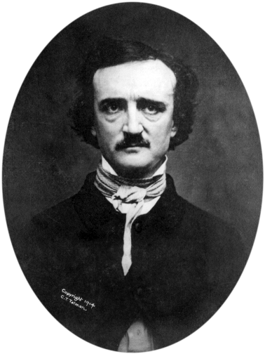
“Human ingenuity cannot concoct a cipher which human ingenuity cannot resolve.”
Edgar Allan Poe, 1841

Slide 2
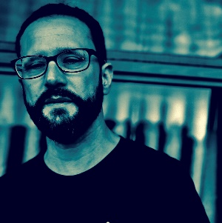
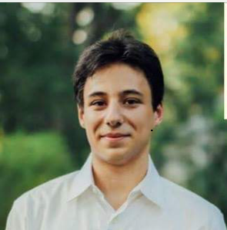
CS-127 / 227r / CSCI E-127: Cryptography
Tue-Thu 10:00am-11:30am, Cabot Science Library
Web page: http://cs127.boazbarak.org (Google “cs 127 boaz”)
Sign up!
Canvas: Get P-sets, quizzes, watch videos. Piazza (web, app): discussions, announcements, questions.
Boaz Barak
Yueqi Sheng
Chi-Ning Chou
Alan Burstein

Slide 3
History of Crypto: 3000BC-1976
Design crypto system
Fix crypto system
Believe impossible to break
Use for life or death applications
Die
System is broken

Slide 4
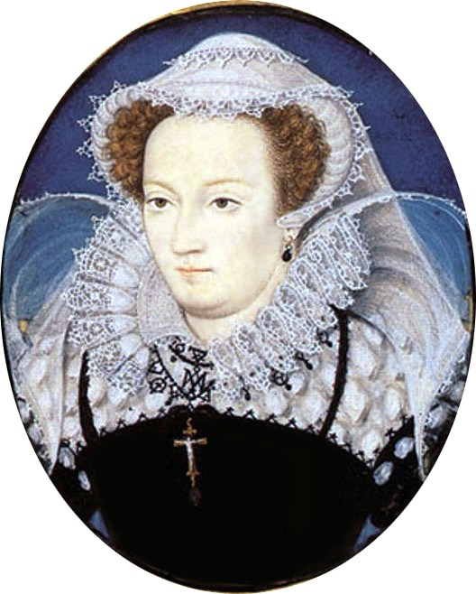
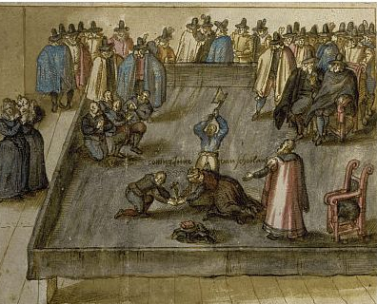
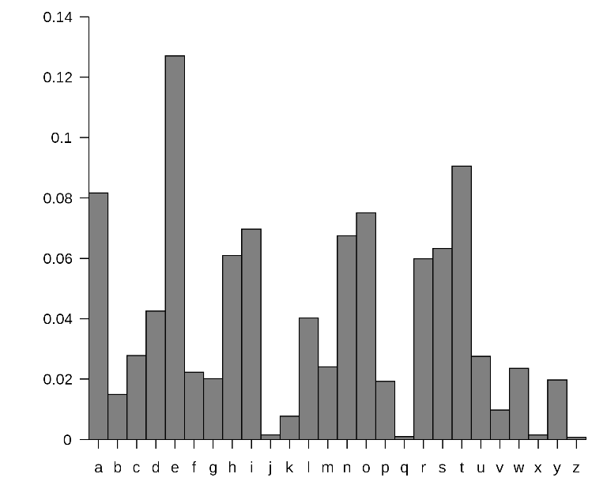
Example 1: Mary’s cipher
Mary queen of Scot planned to assassinate her cousin queen Elisabeth in 1587.
Communicated plot using substitution cipher
Sir Francis Walsingham broke it using frequency analysis

Slide 5
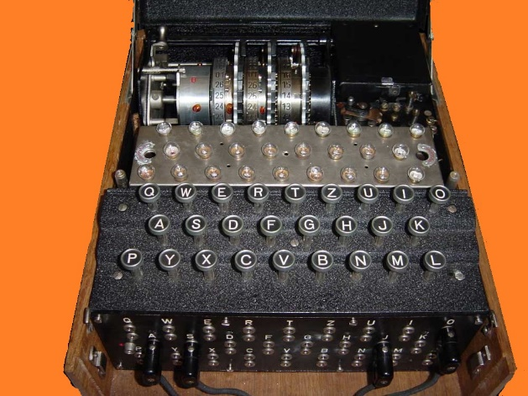
Example 2: Enigma
A typewriter* that based on wires and rotor setting would emit different letter for every keypress.
current state
new state
letter typed
letter output
About ${10}^{113}$ possibilities to set the wirings and rotors.
Lightspeed supercomputer will take ${≫10}^{17}$ years to check them all
(universe is only ${10}^{10}$ years old)
Believed impossible to break by Germans.
Broken via heroic efforts by British at Bletchley park
Cut German U-Boat success in sinking ships by ~90%
Sank about 60% of German U-Boats in Mediterranean
Crucial to success of Normandy D-day landing.

Slide 6
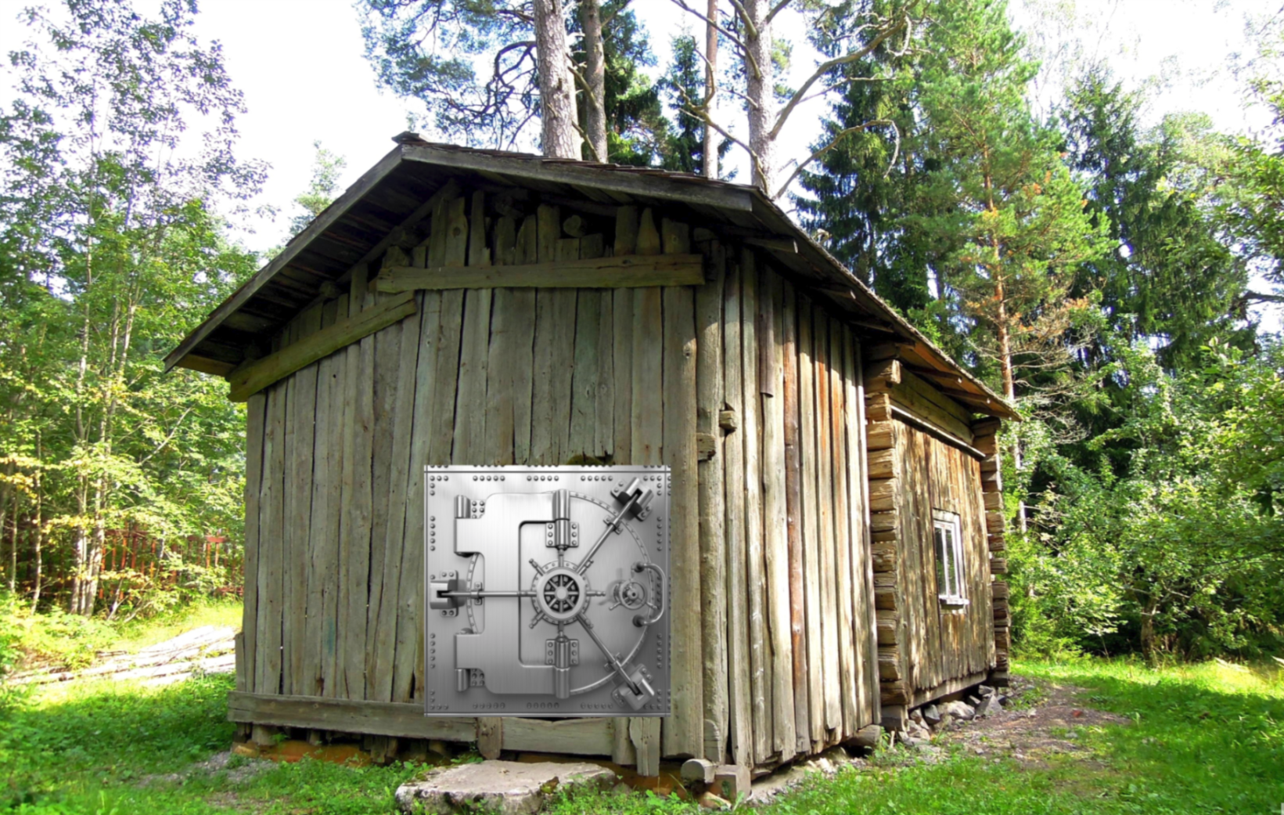
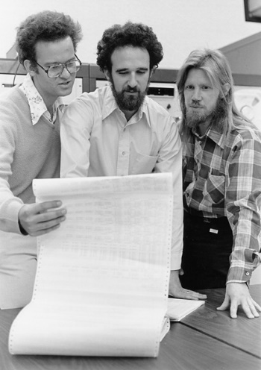
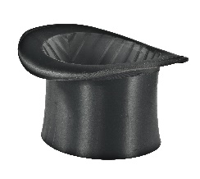
Modern Cryptography (1976- )
“We stand today on the brink of a revolution in cryptography”
Whit Diffie and Martin Hellman, 1976
Data
Cycles
Person-years
Result
Mary’s cipher
${10}^{4}$ bytes
N/A
$$1$$
Broken
Enigma
${10}^{7}$ bytes
$${10}^{13}$$
$${10}^{5}$$
Broken
1976
Diffie-Hellman/RSA
${10}^{22}$ bytes
$${10}^{25}$$
$${10}^{8}$$
Unbroken!
DH/RSA are simpler than Enigma, and allow public encryption key
Security through obscurity
Security through
mathematics
simplicity
Notes:
Yottabyte, exaflop
Source: https://www.intel.com/content/dam/www/public/us/en/documents/white-papers/cost-efficient-ssl-application-delivery-paper.pdf assume about 1-10% of SSL traffic is the handshake.
Cycles, persons based on NSA capabilities

Slide 7
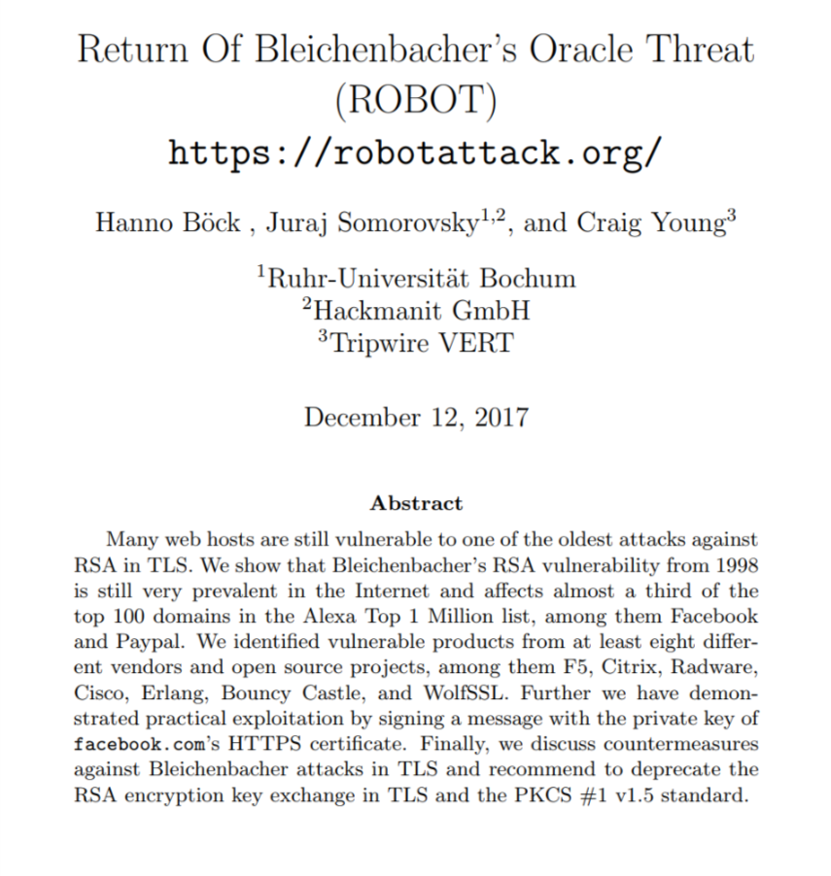
Cryptography and Metaphores
Intuition: $E\left(x\right)= x$
Actually: $E\left(x\right)=$
011001000011111010101110…
Example: malleability
Exists secure encryption in which possible to do
$$x$$
$$x+1$$
Can be devastating for digital auctions.
Used to attack SSL protocol [Bleichenbaher’98]

Slide 8
Malleability for Good
THM [Gentry’09]: Exists* secure encryption where can do:
Fully Homomorphic Encryption
$$x$$
$$x^{′}$$
$$NAND(x,x^{′})$$
$x_{0} { x}_{1} x_{2} … x_{n}$

Slide 9
Witness Encryption [Garg-Gentry-Sahai-Waters’13]
“Digital Puzzle Lockbox”: Publish string $σ$ and alg $A(σ,π)$ that certifiably extracts 1000 bitcoins from $σ$ iff $π$ is valid proof of Riemann Hypothesis.
51 e2 49 b7 4e 64 65 78 00 a4 6c 44 50 b1 19 b5 bb 45 22 76 e5 c2 92 83 69 e5 92 2e 96 db 9d 40 15 e7 8a 50 03 6a 91 4e 6a d5 7a 6b 97 84 04 fa de ab 7f 94 35
04 fb eb 2a 9a 1d 33 d5 f6 d3 4c ff 52 b6 5b 63 b7 08 ac c5 bc 81 89 29 f8 fd 47 88 22 a4 93 32 da ce e5 1b 18 ae 09 f3 64 ba 6f 9e 2d 4a 56 9e 2d 4a 56 ...
Components:
Bitcoin: Hash functions, Encryption, Signatures
Zero Knowledge Proofs: certify fact without revealing secrets.
Succinct Non-interactive ARguments of Knowledge (SNARK): Based on Probabilistically Checkable Proofs (PCPs), hash functions, commitment schemes. (ZK-SNARKS used in z-cash and ethereum cryptocurrencies.)
Witness Encryption based on Indistinguishability Obfsucation, Multilinear Cryptographic Maps. “Fully Homomorphic Encryption on Steroids LSD”

Slide 10
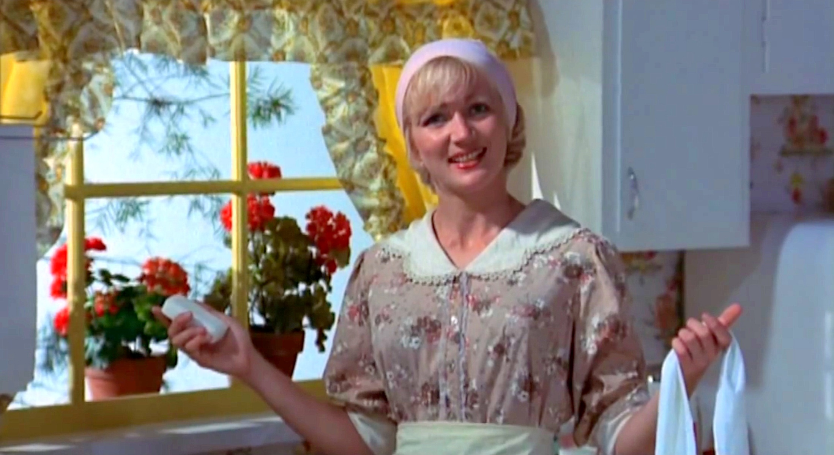
Cryptography and you
Homage to “Zinc Oxide and You” – Kentucky Fried Movie

Slide 20
This course:
Modern and “post modern” cryptography
Perfect security in an imperfect world
Standard undergrad crypto
Private key cryptography: confidentiality and integrity
Public key cryptography: security for the modern world
Attack models: chosen plaintext, chosen ciphertext, person-in-the-middle
Really cool shit
Advanced topics: e-voting, e-auctions, cryptocurrencies
Quantum computing: breaking RSA/DH/ECC
Magic: fully homomorphic encryption, obfuscation
$⇒$ this course will be fast paced.

Slide 21
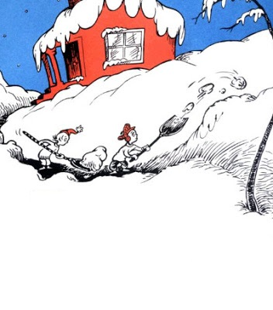
Surviving CS-127
This was no time for play. This was no time for fun. This was no time for games. There was work to be done.

Slide 22
Surviving CS-127
1) Do the reading before each lecture.
2) Do the reading before each lecture.
3) Eat your vegetables: go to lecture, do the P-sets.
4) Ask me (and your TF’s) questions! Here, office hours, sections, Piazza
Typical schedule (shopping week is different):
P-Sets: Due by Wednesday midnight.
Reading: Due before each lecture; online quiz by 9am
This was no time for play. This was no time for fun. This was no time for games. There was work to be done.
You can (even should) do reading/P-sets in groups of $≤3$ students
Other components: Final, optional project, class/online participation

Slide 23
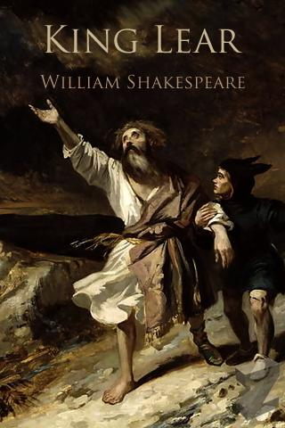
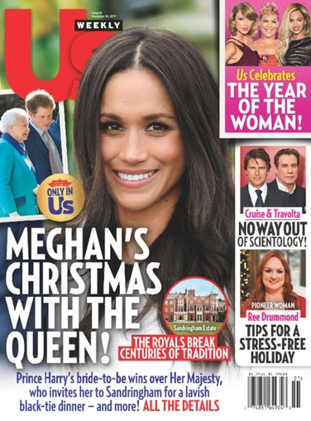
On reading
~20 pages of math per lecture.
Don’t read it like this:
Read it like this:
Google resources, ask Q’s on Piazza, read the textbooks
Come to lecture prepared.

Slide 24
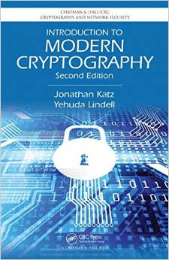
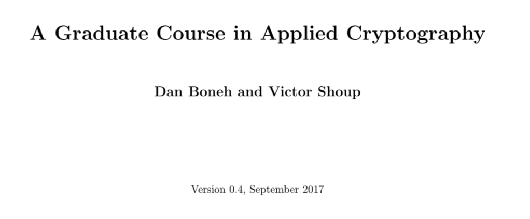
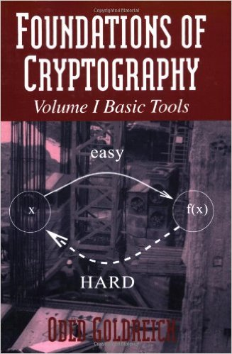
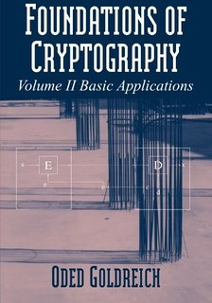
Additional resources

Slide 25
This is not CS 121
Rougher, denser notes (use GitHub Issues to let me know of bugs and typos!)
Quicker pace
Looser policies
Whiteboard lectures (starting Thursday)
(I hope) less emphasis on grades.
Tentative balance w/o project: 10% quizzes, %30 psets, %60 final
Up to +/- letter for participation: don’t be anonymous!
If you succeed in solving most psets you’ll do fine in final.
With project: 10% quizzes, %30 psets, %35 final, 25% project
Exceptions for exceptionally outstanding projects

Slide 26
Defining encryption
Why do we need to formally define security?

Slide 27
Defining encryption
Alice
Bob
Ciphertext: $c=E_{k}(m)$
$$m=D_{k}(c)$$
Key: $k∈{\left\{0,1\right\}}^{n}$
Key: $k∈{\left\{0,1\right\}}^{n}$
Plaintext: $m∈{\left\{0,1\right\}}^{ℓ}$
Eve
Knows $E,D$
(no “security through obscurity”)
Only secret is $k$
$k$ is secret $=$ $k$ is chosen at random
No secrecy without randomness!!
$k$ is uniform in ${\left\{0,1\right\}}^{n}$ $⇒$ Probability of guessing it is $2^{−n}$

Slide 28
Defining encryption
Alice
Bob
Ciphertext: $c=E_{k}(m)$
$$m=D_{k}(c)$$
Key: $k∈{\left\{0,1\right\}}^{n}$
Key: $k∈{\left\{0,1\right\}}^{n}$
Plaintext: $m∈{\left\{0,1\right\}}^{ℓ}$
Eve
Attempt 1: $Pr⁡[$Eve guesses $k$ given $c]≤2^{−n}$
Problem: Could be hard to learn key, but easy to learn message.
Attempt 2: $Pr⁡[$Eve guesses $m$ given $c]≤2^{−n}$
Problem: What if $m$ is either “Yes” or “No”?
Probability over what?
Perfect Secrecy: $∀M⊆{\left\{0,1\right\}}^{ℓ}\underset{m←M,k←{\left\{0,1\right\}}^{n}}{Pr}⁡[$Eve guesses $m$ given $c=E_{k}(m)]≤\frac{1}{\left|M\right|}$
Ciphertext $c$ reveals zero additional information about plaintext $m$

Slide 29
Perfect Secrecy: $∀M⊆{\left\{0,1\right\}}^{ℓ}\underset{m←M,k←{\left\{0,1\right\}}^{n}}{Pr}⁡[$Eve guesses $m$ given $c=E_{k}(m)]≤\frac{1}{\left|M\right|}$
Ciphertext $c$ reveals zero additional information about plaintext $m$

Slide 30
Perfect Secrecy: $∀M⊆{\left\{0,1\right\}}^{ℓ}\underset{m←M,k←{\left\{0,1\right\}}^{n}}{Pr}⁡[$Eve guesses $m$ given $c=E_{k}(m)]≤\frac{1}{\left|M\right|}$
Ciphertext $c$ reveals zero additional information about plaintext $m$

Slide 31
Perfect Secrecy: $∀M⊆{\left\{0,1\right\}}^{ℓ}\underset{m←M,k←{\left\{0,1\right\}}^{n}}{Pr}⁡[$Eve guesses $m$ given $c=E_{k}(m)]≤\frac{1}{\left|M\right|}$
Ciphertext $c$ reveals zero additional information about plaintext $m$
2 to many thm: Suffices to prove for $\left|M\right|=2$
Proof: $\left|M\right|=4$ to $\left|M\right|=2$ : Assume Eve has advantage $ε_{0}>0$ in $\left|M\right|=4$ game
We’ll show Eve’ and $m,m′$ s.t. Eve’ succeeds with prob $\frac{1}{2}+ε′$ in $\{m,m^{′}\}$ game
$$E_{U_{n}}(m_{0})$$
Eve’
$$b=0$$
$$y∈\{E_{U_{n}}\left(m\right), E_{\left(U_{n}\right)}\left(m′\right)\}$$
$$E_{U_{n}}(m_{1})$$
$$m′′$$
$$b=1$$
Eve
$$b=2$$
$$E_{U_{n}}(m_{2})$$
$$b=3$$
$$\underset{m^{′′}∈\left\{m,m^{′}\right\}}{Pr}\left[Eve′\left(E_{U_{n}}\left(m^{′′}\right)\right)=m′′\right]=\frac{1}{2}+ε′$$
$$E_{U_{n}}(m_{3})$$
$$\operatorname{Pr}\left[Eve\left(E_{U_{n}}\left(m_{b}\right)\right)=b\right]=\frac{1}{4}+ε_{0}$$

Slide 32
Perfect Secrecy: $∀M⊆{\left\{0,1\right\}}^{ℓ}\underset{m←M,k←{\left\{0,1\right\}}^{n}}{Pr}⁡[$Eve guesses $m$ given $c=E_{k}(m)]≤\frac{1}{\left|M\right|}$
Ciphertext $c$ reveals zero additional information about plaintext $m$
2 to many thm: Suffices to prove for $\left|M\right|=2$
Proof: $\left|M\right|=4$ to $\left|M\right|=2$ : Assume Eve has advantage $ε_{0}>0$ in $\left|M\right|=4$ game
$$E_{U_{n}}(m_{0})$$
$$E_{U_{n}}(m_{0})$$
$$E_{U_{n}}(m_{0})$$
$$E_{U_{n}}(m_{0})$$
$$b=0$$
$$b=0$$
$$b=0$$
$$b=0$$
$$E_{U_{n}}(m_{1})$$
$$b=1$$
Eve
$$E_{U_{n}}(m_{0})$$
$$b=1$$
Eve
$$E_{U_{n}}(m_{0})$$
$$b=1$$
Eve
$$E_{U_{n}}(m_{0})$$
$$b=1$$
Eve
$$b=2$$
$$b=2$$
$$b=2$$
$$b=2$$
$$E_{U_{n}}(m_{2})$$
$$E_{U_{n}}(m_{2})$$
$$E_{U_{n}}(m_{0})$$
$$E_{U_{n}}(m_{0})$$
$$b=3$$
$$b=3$$
$$b=3$$
$$b=3$$
$$E_{U_{n}}(m_{3})$$
$$E_{U_{n}}(m_{3})$$
$$E_{U_{n}}(m_{3})$$
$$E_{U_{n}}(m_{0})$$
$$\operatorname{Pr}\left[Eve\left(E_{U_{n}}\left(m_{b}\right)\right)=b\right]=\frac{1}{4}+ε_{0}$$
$$⋯=\frac{1}{4}+ε_{1}$$
$$⋯=\frac{1}{4}+ε_{2}$$
$$⋯=\frac{1}{4}+ε_{3}$$
Claim: $ε_{3}=0$
Suppose $ε_{1}>ε_{2}$
Construct Eve’ breaking $\left|M\right|=2$ security with advantage $(ε_{1}−ε_{2})/2$

Slide 33
$$E_{U_{n}}(m_{0})$$
$$E_{U_{n}}(m_{0})$$
$$b=0$$
$$b=0$$
$$E_{U_{n}}(m_{0})$$
$$b=1$$
Eve
$$E_{U_{n}}(m_{0})$$
$$b=1$$
Eve
$$b=2$$
$$b=2$$
$$E_{U_{n}}(m_{2})$$
$$E_{U_{n}}(m_{0})$$
$$b=3$$
$$b=3$$
$$E_{U_{n}}(m_{3})$$
$$E_{U_{n}}(m_{3})$$
$$⋯=\frac{1}{4}+ε_{1}$$
$$⋯=\frac{1}{4}+ε_{2}$$
Suppose $ε_{1}>ε_{2}$
Construct Eve’ breaking $\left|M\right|=2$ security with advantage $(ε_{1}−ε_{2})/2$

Slide 34
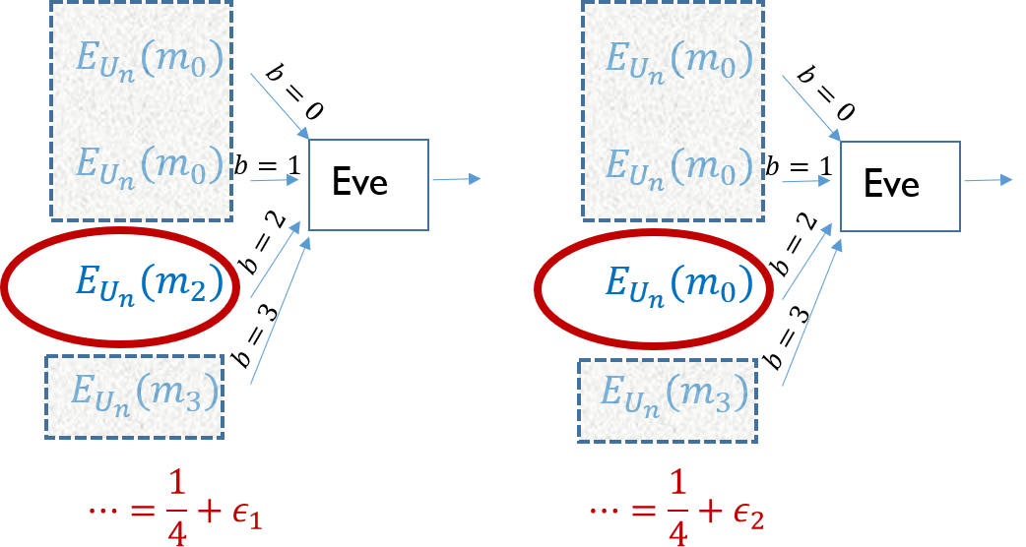
Suppose $ε_{1}>ε_{2}$
Construct Eve’ breaking $\left|M\right|=2$ security with advantage $(ε_{1}−ε_{2})/2$

Slide 35
Suppose $ε_{1}>ε_{2}$
Construct Eve’ breaking $\left|M\right|=2$ security with advantage $(ε_{1}−ε_{2})/2$
$$E_{U_{n}}(m_{0})$$
Eve’
$Eve^{′}\left(y\right)=m_{2}$ iff $b=b^{′}$, otherwise output $m_{1}$
$$b=0$$
$$b=1$$
$$b′$$
$$\operatorname{Pr}\left[Eve^{′}\left(m_{2}\right)=m_{2}\right]=\frac{1}{4}+ε_{1}$$
$$E_{U_{n}}(m_{0})$$
Eve
$$y∈\{E_{U_{n}}\left(m_{2}\right), E_{\left(U_{n}\right)}\left(m_{0}\right)\}$$
$$b=2$$
$$y$$
$$\operatorname{Pr}\left[Eve^{′}\left(m_{0}\right)=m_{2}\right]=\frac{1}{4}+ε_{2}$$
$$b=3$$
$$E_{U_{n}}(m_{3})$$
$$\operatorname{Pr}\left[Eve^{′}\left(m_{0}\right)=m_{1}\right]=\frac{3}{4}−ε_{2}$$
$$\operatorname{Pr}\left[Eve^{′}\left(m_{b}\right)=m_{b}\right]=\frac{1}{2}\left[\frac{1}{4}+ε_{1}\right]+\frac{1}{2}\left[\frac{3}{4}−ε_{2}\right]=\frac{1}{2}+\frac{ε_{1}−ε_{2}}{2}$$

Slide 36
Perfect secrecy
SKIP
$$m∈{\left\{0,1\right\}}^{ℓ},k∈{\left\{0,1\right\}}^{n}, D_{k}\left(E_{k}\left(m\right)\right)=m$$
$$1^{n}$$
$${E_{1^{n}}(m}_{0})$$
$$m_{0}$$
…
$$0^{n}$$
$$0^{n−1}1$$
ciphertexts
$2^{ℓ}$ plaintexts
$${E_{0^{n}}(m}_{0})$$
$$0^{n}$$
$${E_{0^{n}}(m}_{1})$$
$$m_{1}$$
…
$$1^{n}$$
$${E_{0^{n−1}1}(m}_{0})$$
$${=E_{1^{n}}(m}_{1})$$
Assume $E$ doesn’t ignore parts of key: $E_{k}\left(m\right)≠E_{k^{′}}\left(m\right)$ if $k≠k′$.
Claim 1: If $(E,D)$ perfectly secret then every ciphertext reachable from $m_{0}$ is also reachable from $m_{1}$
Claim 2: If for every $m_{0},m_{1}$ every ciphertext reachable from $m_{0}$ is also reachable from $m_{1}$ then $\left(E,D\right)$ is perfectly secret.

Slide 37
Unbreakable encryption
Theorem: $∃$ perfectly secret encryption.
Proof: One bit perfectly secret encryption:
$$k$$
$$0$$
$$1$$
$$0$$
$$0$$
$$m$$
$$0$$
$$0$$
$$1$$
$$1$$
$$1$$
$$1$$
$$1$$
$$0$$
Encrypt $ℓ$ bits $⇒$ repeat $ℓ$ independent keys
$$m∈{\left\{0,1\right\}}^{ℓ},k∈{\left\{0,1\right\}}^{ℓ}, E_{k}\left(m\right)=m⊕k$$
One time pad – used for U.S. and Soviet top secret communication.
“one time pad” $≈$ “point away from you gun”

Slide 38
Limitation of perfect security
Thm: If $(E,D)$ is perfectly secret then |key size|$≥$|message size|
Proof: $m∈{\left\{0,1\right\}}^{ℓ},k∈{\left\{0,1\right\}}^{n}$, suppose that $n<ℓ$
$$1^{n}$$
$$m_{0}$$
…
$$0^{n}$$
$$0^{n}$$
$2^{n}$ciphertexts
$2^{ℓ}$ plaintexts
$$0^{n−1}1$$
$$m_{1}$$

Slide 39
Summary
It is possible to mathematically define security for encryption
Guarantees encryption is unbreakable:
(for eavesdropping adversary)
No matter what Eve does, she can’t learn anything about the plaintext that she didn’t know before.
Requires key to be larger than message.
Huge problem in practice: we want $128$ bit key for gigabytes (if not terrabytes) of communication.

Slide 40
For Thursday
Join Piazza and Canvas (put course in Cart) if you haven’t already
Read Lecture 2: Computational Security
Do not so short quiz on canvas by Thursday 9am.
Homework zero due on Thursday midnight
Homework one published Thursday afternoon, due next Wednesday midnight.

Slide 41
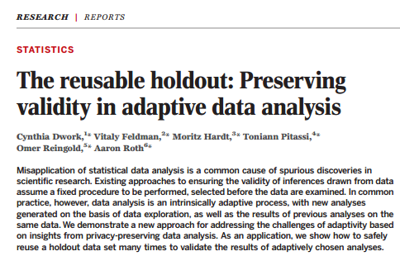
Overtime: Using the crypto mindset beyond crypto
One example: preventing overfitting in machine learning.
Training
Classifier
Idea: Treat training algorithm as attacker to prevent it learning “too much” about the particular sample.

